Slide 1

Apache Kafka

Slide 2

Agenda
Introduction
01
Cluster architecture overview
02
Demo
(ETL workflow)
03

Slide 3
Introduction
Apache Kafka is an open-source distributed streaming system used for stream processing, real-time data pipelines, and data integration at scale.
Originally created to handle real-time data feeds at LinkedIn in 2011
Kafka quickly evolved from messaging queue to a full-fledged event streaming platform capable of handling over 1 million messages per second, or trillions of messages per day
In comparison to other messaging systems, Kafka has better throughput, built-in partitioning, replication and inherent fault-tolerance, which makes it a good fit for large-scale message processing applications.

Slide 4
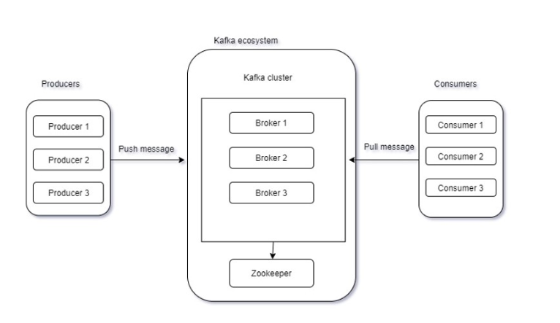
Cluster architecture overview

Slide 5
Architecture
Kafka Broker
Node where topics are stored
Kafka Connect
Used for creating Producer/Consumer instances
Restapi endpoints available to create, update, delete connectors
Schema registry
It stores schema of topic message (both key and value)
Restapi endpoints available to store and retrieve schema
KSQL
Streaming engine for apache kafka
Used for processing and transforming data from one topic to another

Slide 6
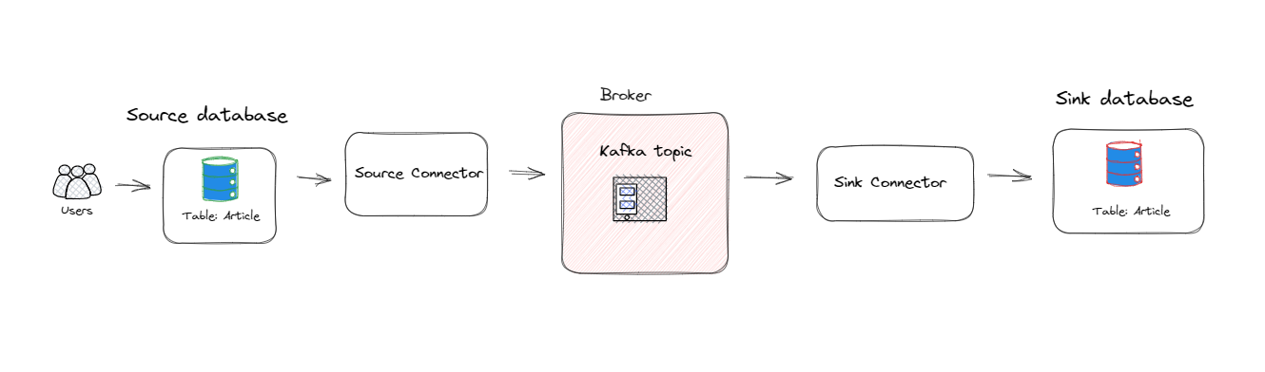
Demo

Slide 7
Assignment
Create an ETL data pipeline with the help of Kafka connect.
Requirements are,
Source side database server: Postgresql
Sink side database server: Sql Server

Slide 8
References
Source connector(sql-server): https://debezium.io/documentation/reference/2.1/connectors/sqlserver.html
Sink connector(sql-server): https://docs.confluent.io/kafka-connectors/jdbc/current/sink-connector/sink_config_options.html#connection
Kafka connect restapi endpoints: https://docs.confluent.io/platform/current/connect/references/restapi.html#connectors
Single message transformations: https://docs.confluent.io/platform/current/connect/transforms/overview.html
Schema registry: https://docs.confluent.io/platform/current/schema-registry/index.html
Change data capture(CDC): https://learn.microsoft.com/en-us/sql/relational-databases/track-changes/about-change-data-capture-sql-server?view=sql-server-ver16

Slide 9
Thanks

